Slide 1
Applied Data science capstone - project
Capstone project – the battle of neighborhood – week1

Slide 2
Immigrants in canada

Slide 3
Immigrants in Canada
More than 60% of immigrants between 2011 and 2016 were admitted to Canada as economic migrants.
Almost an eighth of immigrants who landed and permanently settled in Canada in the five-year period between 2011 and 2016 were from India, according to the latest results from the 2016 census released by Statistics Canada.
In its table for the top 10 countries of birth of recent immigrants in 2016, those from India - at 147,190 - account for 12.1% of total number of 1212075.
According to the document, the largest contingent of visible minorities in Canada is from South Asia, with 1,924,635people representing more than 25% of that particular population

Slide 4
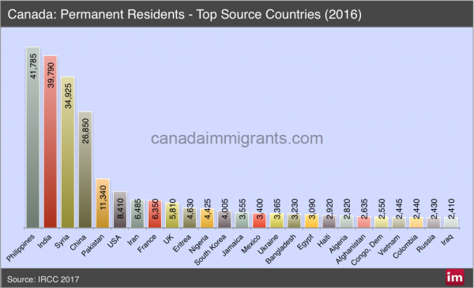
Immigrants in Canada
The next two largest visible minority groups are the Chinese (at 20.5% of the total) and blacks (at 15.6% of that population).
Given the three largest source countries of new Canadian immigrants, it isn’t surprising that nearly half the foreign-born population is from Asia

Slide 5
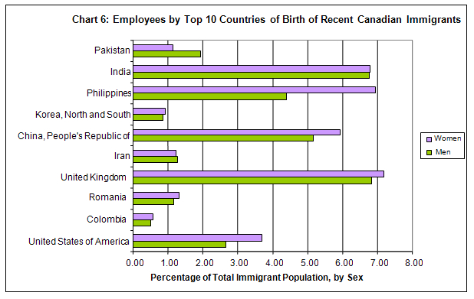
Immigrants in Canada

Slide 6
Introduction / business problem
Based on the above analysis it would be a good idea to setup an restaurant in Canada based on the population of the immigrants.
As majority of the immigrants are from India, if we can setup an Indian restaurant based on the number of Indian restaurant and population of the Indian in each city of Canada.
The objective is to check each city of Canada and located the number of Indian restaurant and then suggest an location based on the population density and cuisines like of the people.

Slide 7
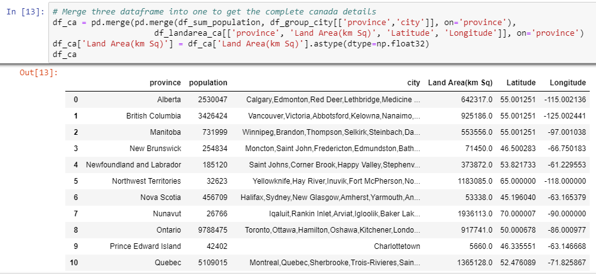
Report
Based on the analysis using the foursquare api, we found that there are around 13 Provinces in Canada city. Please refer the below table:

Slide 8

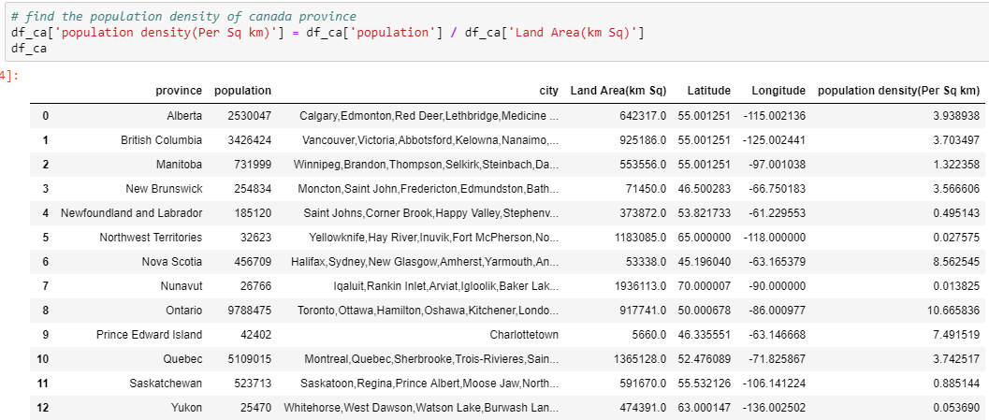
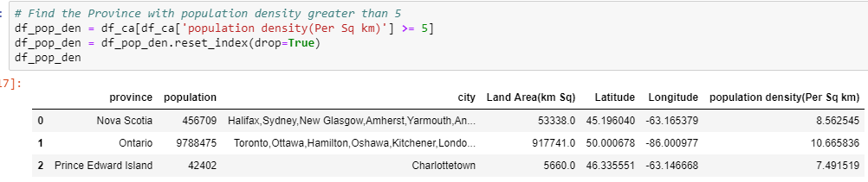
From the above table calculated the population density of each province and filtered out the provinces which have density <= 5, Please refer the below table:

Slide 9

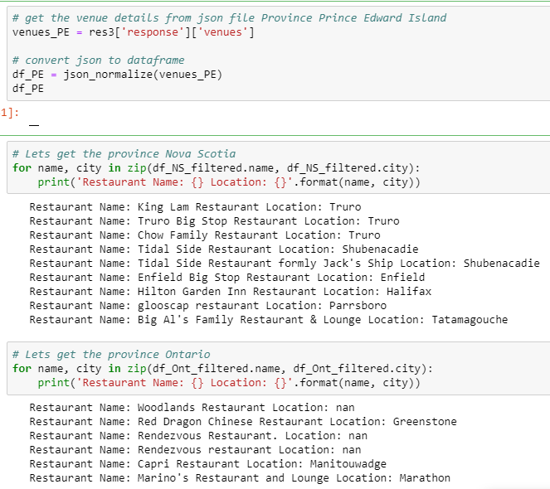
Based on the location we filtered only the restaurant and found that in city Charlottetown there were very less restaurant and this would be an ideal location for opening the New restaurant.

Slide 10
Thank you

